Slide 1
Python

Slide 2
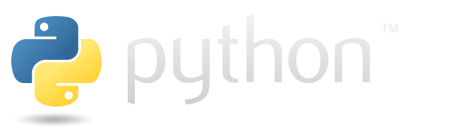
Python.org https://www.python.org/

Slide 3
> python -V
Python 3.14.0
> pip -V
pip 25.3 from C:\Python\Python314\Lib\site-packages\pip (python 3.14)

Slide 4
Python
Python is a high-level, general-purpose programming language; its design philosophy emphasizes code readability with use of significant indentation
Python is dynamically type-checked and garbage-collected; supports multiple programming paradigms, including structured (particulary proce - dural), object-oriented and functional programming
Guido van Rossum began working on Python in late 1980s Python 3.0, was major revision and not completely backward-compatible with earlier vers.
Python has gained widespread use in the machine learning community; it is widely taught as introductory programming language
since 2000, Python has consistently ranked in top ten of most popular programming languages in the Programming Community Index

Slide 5
pip
pip is a package manager (package management system) written in Python and is used to install and manage software packages
the Python Software Foundation recommends using pip to install Python applications and its dependencies during deployment
connects to an online software repository of public packages, named the Python Package Index (PyPI); can be configured to connect to other package repositories (local or remote), provided that they comply to Python Enhancement Proposal
most distributions of Python come with pip preinstalled, Python 3.4 and later include pip by default

Slide 6
a way to install Python is to use individual edition of Anaconda distribution, available at Anaconda Advance AI with Open Source | Anaconda https://www.anaconda.com/
open-source and compatible with Linux, macOS, Windows, …
offers two versions:
  full distribution includes over 300 pre-installed data science and machine learning packages but requires more disk space
  Miniconda is lightweight installer that includes only conda, Python, a few essential packages (possible to install latter packages …)

Slide 7
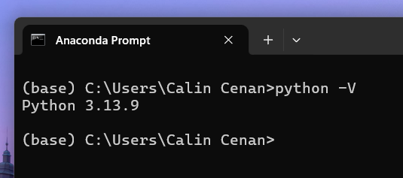
once the Miniconda is installed, can open Anaconda Prompt

Slide 8
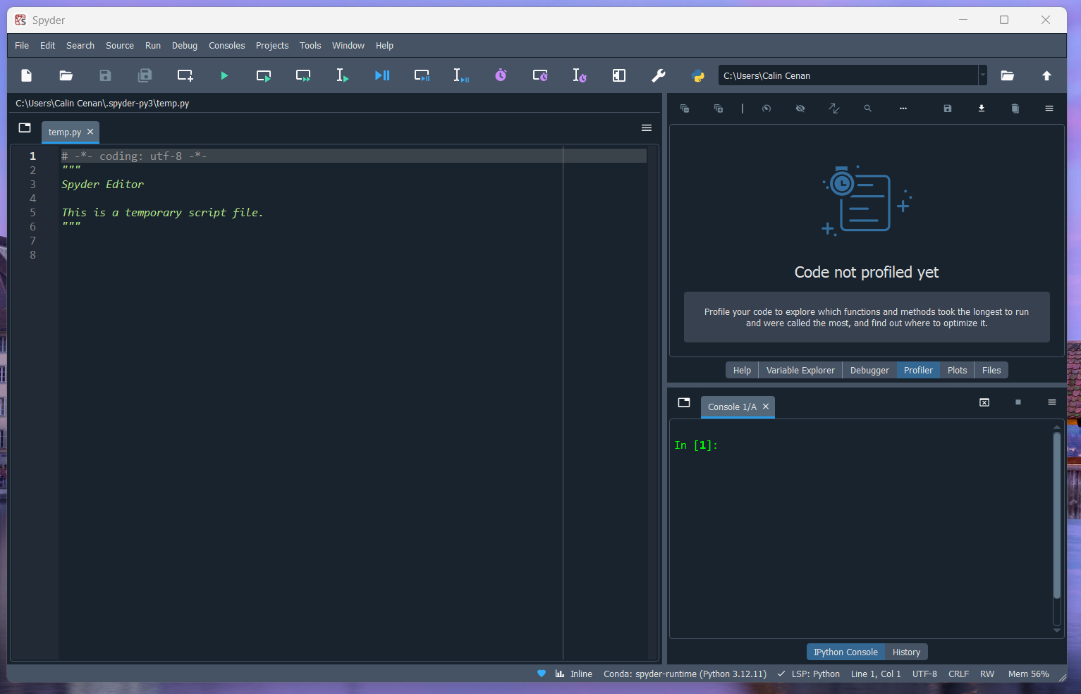
Spyder | Python IDE scientists and data analysts deserve
https://www.spyder-ide.org/

Slide 9
Python
Python is a high-level, interpreted programming language known for its simplicity, readability, and versatility; has grown to become one of the most popular programming languages in the world
philosophy emphasizes code readability with the use of significant whitespace and a clean, elegant syntax
interpreted language
dynamically typed
Object-Oriented
extensive libraries
cross-platform compatibility: Linux, macOS, Windows, …
open-source: free

Slide 10
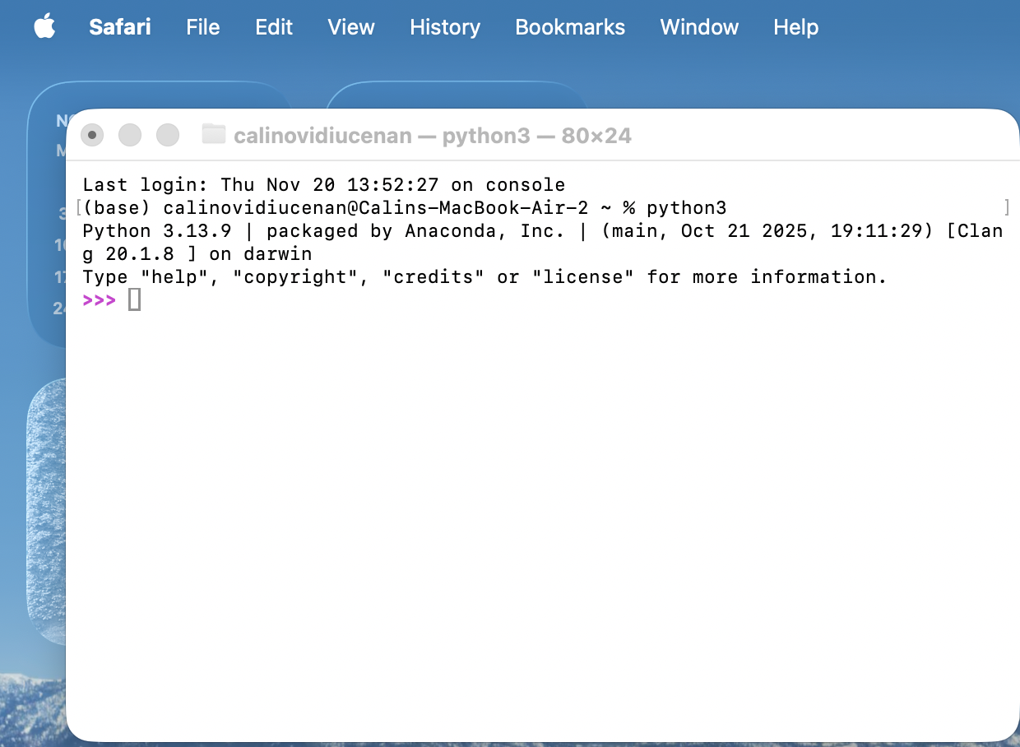

Slide 11
#!/usr/bin/env python3
# -*- coding: utf-8 -*-
"""
Spyder Editor This is a script file.
This is a docstring. It's used to provide a brief description
of the script's purpose and functionality.
"""
import math
from datetime import datetime
def greet(name):
return f"Hello, {name}!"
class Person:
def __init__(self, name, age):
self.name = name
self.age = age
if __name__ == "__main__":
# Code to run when the script is executed directly
print("This is the main execution block")

Slide 12
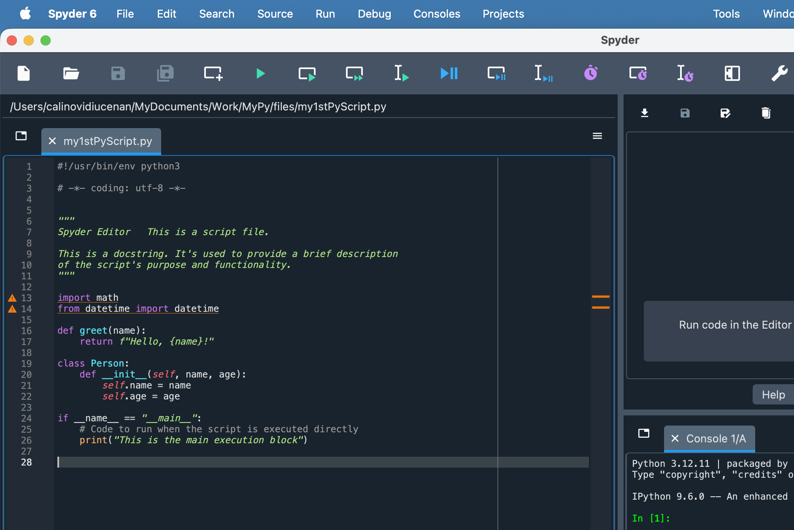

Slide 13
Python script structure
Shebang line (optional, for Unix-like systems):
Docstring (optional, but recommended):
Import statements
Constants and global variables:
Function definitions
Class definitions
Main execution block:
  class keyword, followed by the class name.
  if __name__ == "__main__":
  # Code to run when the script is executed directly
  print("This is the main execution block")

Slide 14
Variable Data types
Data Structures

Slide 15
Variables and data types
don't need to declare the type of variable - interpreter infers
variable names can contain letters, numbers, and underscores; must start with letter or _underscore
are case-sensitive
follow the snake_case convention for variable names

Slide 16
Data Types
Integers (int)
Floating-point numbers (float): numbers with decimal points
Strings (str): sequences of characters, enclosed in 'single' or "double" quotes
Booleans (bool): represents True or False values
None: represents the absence of a value or a null value

Slide 17
Data Types
Lists: ordered, mutable sequences of elements
fruits = ["apple", "banana", "cherry"]
numbers = [1, 2, 3, 4, 5]
Tuples: ordered, immutable sequences of elements
coordinates = (10, 20)
rgb = (255, 0, 0)
Dictionaries: unordered collections of key-value pairs
person = {"name": "Alice", "age": 5, "city": "Doesn't Live Here Anymore"}
Sets: unordered collections of unique elements
unique_numbers = {1, 2, 3, 5, 8}

Slide 18
hello_world.py
# This is a comment. Comments are ignored by Python interpreter
print("Starting the program...")
# Variable assignment
message = "Hello, World! from Python"
# Function definition
def greet(name):
return f"My name is, {name}!"
# Main execution
print(message)
print(greet("Calin"))
print("Ending the program...")

Slide 19
single and double quotes are used for single-line strings
triple quotes are used for multi-line strings - can also include both single and double quotes without escaping them
strings area special type of data, sequence of characters, where each character has specific position, known as its index – when indexed from left to right, the characters are assigned indices starting from 0 up to n−1, where n is the length of string; when indexed from right to left, the characters are assigned indices starting from −1down to −n

Slide 20
s1 = "a string"
print(len(s1))
print(s1[0:2])
print(s1[-1])
print(s1[-3:-1])
print(s1[-3:])
8
a
g
in
ing

Slide 21
+ concatenates two strings
* repeats a string
[:] slices string based on character positions
in checks if string is substring of another string
replace replaces substring within string with another substring
split splits string into list of substrings using specified delimiter
format formats string by replacing placeholders () with specified values
join joins list of strings into single string using specified delimiter

Slide 22
Data Structure - List
ordered collection of elements, which can be of any data type
lists are defined using square brackets [], with elements separated by commas
lst1 = ["a string", 2, True]
lists are mutable, for example, can add an element to the end of list by using function append:
lst1.append(3.141592)
can also insert element into specified position
lst1.insert(0, 'begin') lst2 = ['another', 'string'] lst1.insert(1, lst2)

Slide 23
fruit_list = ["apple", "banana", "cherry"]
for fruit in fruit_list:
print(fruit)
apple
banana
cherry

Slide 24
Methods for accessing elements in a list:
  [pos] - gets the element with index pos
  [start:stop] - gets elements with indices from start (inclusive) to stop (exclusive)
  [start:stop:stride] - gets elements with indices from start (inclusive) to stop (exclusive) with step size stride
see that method [::-1] essentially reverses the list

Slide 25
Data Structure - Tuple
similar to a list, however, tuples are immutable - once tuple is created, it cannot be modified
tuples are defined by parentheses and elements of tuple are separated by commas
tpl2 = ("a string", 2, True)
elements of tuple can be accessed by square brackets with indices tpl2[2])

Slide 26
fruit_tuple = ("apple", "banana", "cherry")
for fruit in fruit_tuple:
print(fruit)
apple
banana
cherry

Slide 27
Data Structure - Dictionary
store key-value pairs
created by using curly brackets and key-value pairs are separated by commas; key and value of a pair are separated by a colon:
dict3 = {"One" : 1, "Two" : 2, 3 : 'c’}
values in dictionary can be accessed by their keys dict3['Two']

Slide 28
fruit_dictionary = {"apple" : "red", "banana" : "green", "cherry" : "blue"}
for k, v in fruit_dictionary.items():
print(f"{k} is {v}")
apple is red
banana is green
cherry is blue

Slide 29
Data Structure - Set
collection of unordered and unique elements
created using curly brackets {} or the set function
s1 = set() s1.add(1) s1.add("a")
s2 = {1, "a", "b", True, False}
sets automatically eliminate duplicate values, ensuring that each item appears only once

Slide 30
fruit_set = {"apple", "banana", "cherry"}
for fruit in fruit_set:
print(fruit)
cherry
banana
apple

Slide 31
Control statements

Slide 32
Control Statements and Loops
manage flow of execution within a program
if, if-else, and if-elif-else
loops in Python include for loop, which iterates over a sequence, and while loop, which repeats as long as a given condition remains true
x = 1
if x > 0:
print("x is positive")
print("and something more ...")
else:
print('x is negative')

Slide 33
dSum1 = 0
for i in range(3, 89+1):
dSum1 += i
print(dSum1 - (89-3) * 2)
dSum2 = 0
i = 3
while i <= 89:
dSum2 += i
i += 1
print(dSum2 - (89-3) * 2)

Slide 34
dSum = 0
for i in range(1, 1001):
dSum += i
if i % 100 == 0:
print("Iteration {}: {}".format(i, dSum))

Slide 35
Python includes two key statements for controlling loops: break and continue

Slide 36
for loop
for loop is used to iterate over a sequence (like list, tuple, string) or other iterable objects
fruits = ["apple", "banana", "cherry"]
for fruit in fruits:
print(fruit)

Slide 37
Functions

Slide 38
Functions
defined to encapsulate blocks of reusable code
accept arguments (inputs) and return values (outputs); arguments are specified inside parentheses of function definition
supports different types of arguments:
  positional arguments
  keyword arguments
  default arguments
  variable-length arguments: use *args for variable number of positional arguments and **kwargs for variable number of keyword arguments

Slide 39
functions can return values using the return statement
function can return multiple values as a tuple
if no return statement is used, function returns None by default

Slide 40
Lambda functions
also known as anonymous functions, nameless function typically used for short, simple operations where a full function definition is unnecessary, particularly useful for quick, inline functionality
square = lambda x: x ** 2
print(square(5)) # Output: 25

Slide 41
x = [(lambda x: math.sqrt(x))(i) for i in range(1,11)]
print(x)
[1.0, 1.4142135623730951, 1.7320508075688772, 2.0, 2.23606797749979, 2.449489742783178, 2.6457513110645907, 2.8284271247461903, 3.0, 3.1622776601683795]

Slide 42
Files

Slide 43
File Input Output
functions for file handling
ensure that Python can locate the file
import os
fi = open(os.path.join(r"c:\users\...\documents\ …", "file.txt"), "r")
content = fi.read()
fi.close()
print(content)

Slide 44
with open(os.path.join(r"c:\users\...", "file.txt"), "r") as fi:
content = fi.read()
print(content)

Slide 45
Error handling

Slide 46
using the try-except statement

Slide 47
Object Oriented Programming

Slide 48
Object-Oriented Programming OOP
programming paradigm that uses objects to structure programs
object models real-world entity and contain data and methods
OOPis built on encapsulation, inheritance, and polymorphism
encapsulation integrates data and methods into a single unit, the class, restricting direct access to certain details
inheritance allows new class to derive from an existing class, inheriting its data and methods
polymorphism enables a single interface to represent different underlying implementations, allowing for flexible and dynamic behavior

Slide 49
Modules and Packages

Slide 50
Modules and Packages
are ways to organize and reuse code in Python, allow to break down large programs into smaller, more manageable files and provide a mechanism for namespacing to avoid naming conflicts

Slide 51
Import Module
a module is a file containing Python definitions and statements
file name is the module name with the suffix .py added
can create your own modules by saving Python code in a .py file
to use module in Python script, need to import it:
import math
print(math.pi)
print(math.sqrt(16))
# Output: 3.141592653589793
# Output: 4.0

Slide 52
can import specific items from a module:
import math import pi, sqrt
print(pi)
print(sqrt(16))

Slide 53
can use aliases to rename imported modules or items:
import math as m
print(m.pi)
from math import sqrt as square_root
print(square_root(16))

Slide 54
Packages
is a way of organizing related modules into a directory hierarchy
a directory containing a special file called __init__.py (which can be empty) and other Python files

Slide 55
an example of a package structure:
mypackage/
__init__.py
module1.py
module2.py
subpackage/
__init__.py
module3.py

Slide 56
can import modules from a package like this:
from mypackage import module1
from mypackage.subpackage import module3

Slide 57
pip
use pip to Install Packages - pip is the package installer for Python, additional packages that are not part of Python standard library
pip install package_name

Slide 58
pip install --upgrade package_name
pip uninstall package_name
pip list

Slide 59
can create requirements.txt file to specify dependencies for project:
# requirements.txt
requests==2.25.1
numpy==1.20.1
pandas==1.2.3
then, can install all dependencies at once using:
pip install -r requirements.txt

Slide 60
Virtual Environments
when working on multiple Python projects, it's a good practice to use virtual environments
virtual environments allow you to have a separate set of Python packages for each project, avoiding conflicts between package versions
to create a virtual environment, use venv module:
python -m venv myenv

Slide 61
Virtual Environments
activating virtual environment on
  Windows: myenv\Scripts\activate On
  macOS and Linux: source myenv/bin/activate
once activated, any packages you install using pip will be isolated to this environment
to exit virtual environment:
deactivate
can ensure that each of your Python projects has its own set of dependencies, regardless of what other projects on your system require

Slide 62
Jupyter Notebook

Slide 63
Jupyter Notebook
Jupyter https://jupyter.org/ Jupyter Notebook is an open-source web application that allows you to create and share documents containing live code, equations, visualizations, and narrative text
can be used for various Python programming tasks
popular in data science and scientific computing

Slide 64
install Jupyter Notebook
Python installed on your system; and pip
terminal, command line interface
install Jupyter using pip, Python's package installer:
  pip install jupyter

Slide 65
jupyter --version
Selected Jupyter core packages...
IPython : 9.7.0
ipykernel : 7.1.0
ipywidgets : 8.1.8
jupyter_client : 8.6.3
jupyter_core : 5.9.1
jupyter_server : 2.17.0
jupyterlab : 4.5.0
nbclient : 0.10.2
nbconvert : 7.16.6
nbformat : 5.10.4
notebook : 7.5.0
qtconsole : not installed
traitlets : 5.14.3
to verify installation, run:
jupyter --version
alternatively, can install Jupyter as part of Anaconda and once installed, can launch Jupyter Notebook from Anaconda Navigator or Anaconda prompt command line

Slide 66
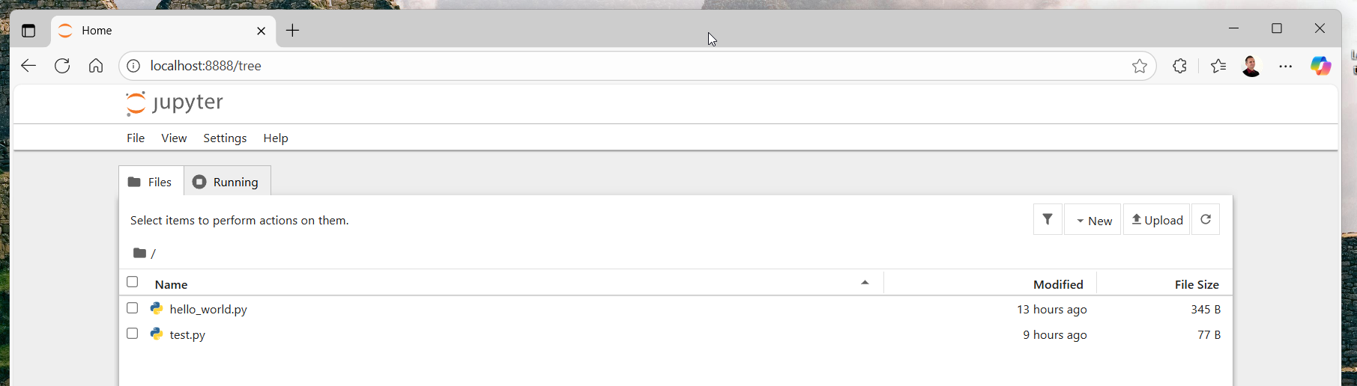
open terminal command line interface
navigate to directory where you want to create your notebook
run the command: jupyter notebook

Slide 67
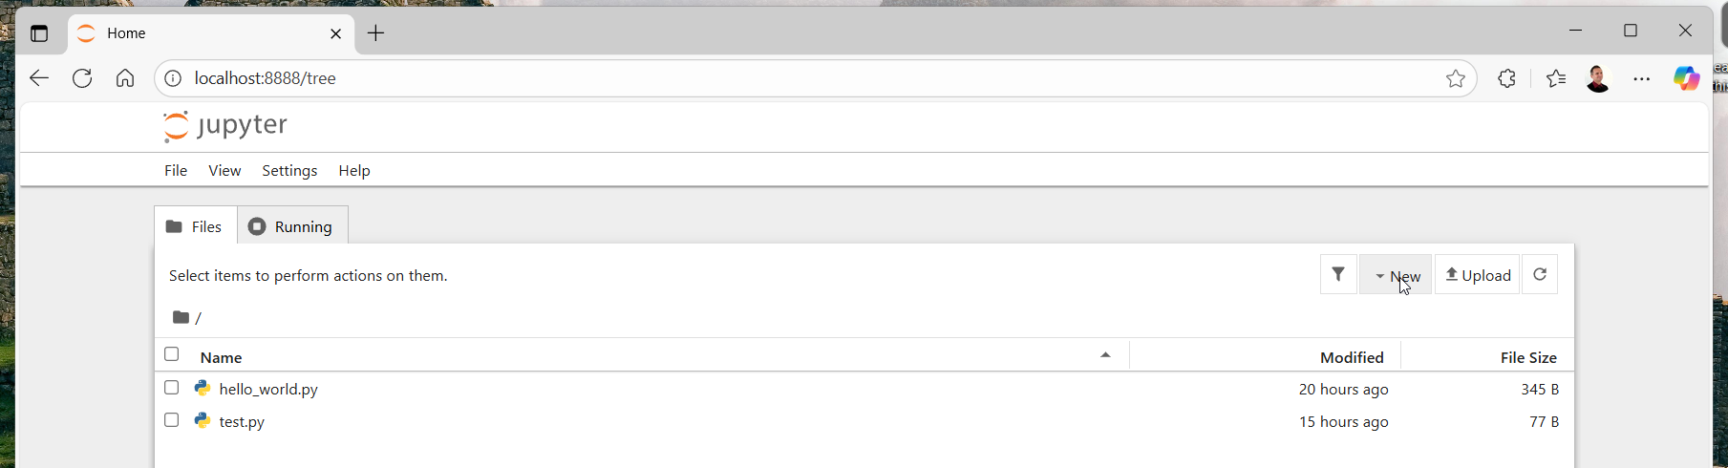
Create new notebook
in the Jupyter interface, click on "New" in the top right corner
select "Python 3" (or the appropriate kernel) from dropdown menu
new notebook will open in a new tab

Slide 68
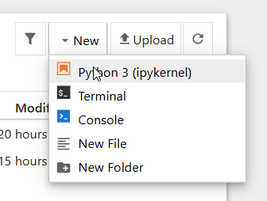
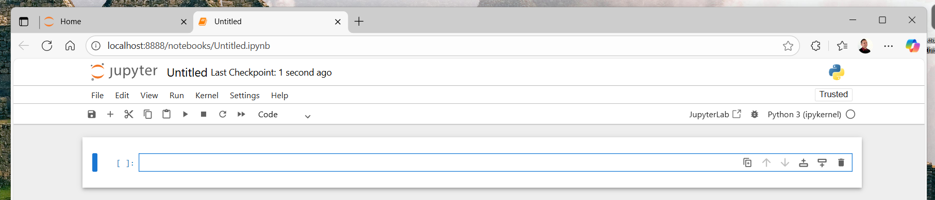

Slide 69
Jupyter interface
notebook consists of cells, which can contain code or markdown text
toolbar provides options for running cells, changing cell types, …
kernel indicator in top right shows status of Python kernel
to write code, simply type in a code cell
to execute code in cell, press Shift+Enter or click "Run" button
  output will appear below the cell

Slide 70
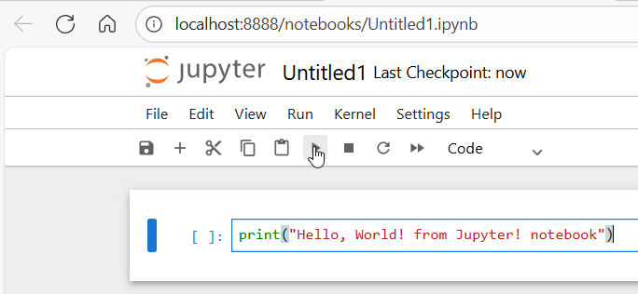
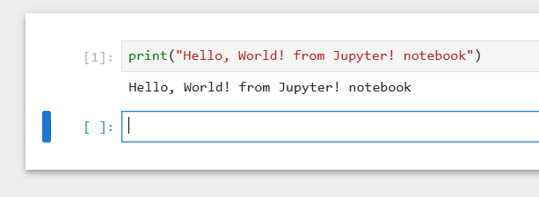

Slide 71
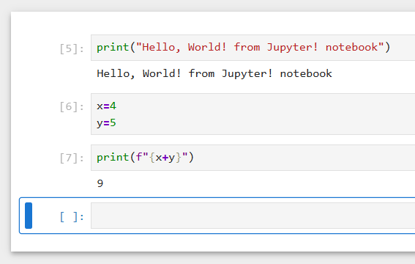
in cell, can define variables and use them in subsequent cells

Slide 72
import matplotlib.pyplot as plt
import numpy as np
x = np.linspace(0, 10, 100)
y = np.sin(x)
plt.plot(x, y)
plt.title("Sine Wave")
plt.xlabel("x")
plt.ylabel("sin(x)")
plt.show()

Slide 73
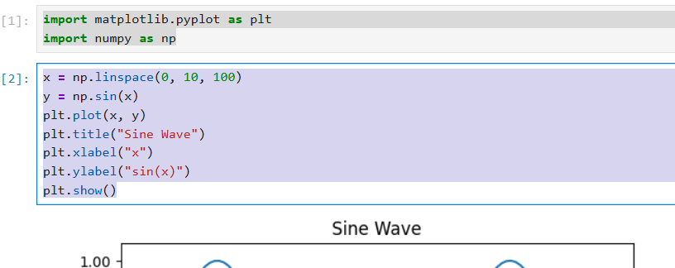

Slide 74
